Slide 1
Virtualization for Data-Center Automation
Server Consolidation in Data Centers
Virtual Storage Management
Cloud OS for Virtualized Data Centers
Trust Management in Virtualized Data Centers

Slide 2
Virtualization
Virtualization for Data-Center Automation
Data centers have grown rapidly in recent years, and all major IT companies are pouring their resources into building new data centers.
In addition, Google, Yahoo!, Amazon, Microsoft, HP, Apple, and IBM are all in the game.
All these companies have invested billions of dollars in datacenter construction and automation.
Data-center automation means that huge volumes of hardware, software, and database resources in these data centers can be allocated dynamically to millions of Internet users simultaneously, with guaranteed QoS and cost-effectiveness.
This automation process is triggered by the growth of virtualization products and cloud computing services and software development.

Slide 3
Server Consolidation in Data Centers
In data centers, a large number of heterogeneous workloads can run on servers at various times.
These heterogeneous workloads can be roughly divided into two categories:
Chatty workloads may burst at some point and return to a silent state at some other point.
Ex: A web video service, whereby a lot of people use it at night and few people use it during the day.
Non interactive workloads do not require people’s efforts to make progress after they are submitted.
Ex: High-performance computing.
At various stages, the requirements for resources of these workloads are dramatically different.
However, to guarantee that a workload will always be able to cope with all demand levels, the workload is statically allocated enough resources so that peak demand is satisfied.

Slide 4
Therefore, it is common that most servers in data centers are underutilized.
A large amount of hardware, space, power, and management cost of these servers is wasted.
Server consolidation is an approach to improve the low utility ratio of hardware resources by reducing the number of physical servers.
Among several server consolidation techniques such as centralized and physical consolidation, virtualization-based server consolidation is the most powerful.
Data centers need to optimize their resource management.
In general, the use of VMs increases resource management complexity.
This causes a challenge in terms of how to improve resource utilization as well as guarantee QoS in data centers.

Slide 5
Thus, server virtualization has the following side effects:
1) Consolidation enhances hardware utilization.
Many underutilized servers are consolidated into fewer servers to enhance resource utilization, also facilitates backup services & disaster recovery.
2) Enables more agile provisioning and deployment of resources.
3) Total cost of ownership is reduced.
4) Improves availability and business continuity.
It becomes easier to transfer a VM from one server to another, because virtual servers are unaware of the underlying hardware.
In virtualized data centers, an efficient, on-demand, fine-grained scheduler is one of the key factors to improve resource utilization.
Scheduling and reallocations can be done in a wide range of levels (VM level, server level, and data-center level).
Ideally, scheduling and resource reallocations should be done at all levels.
However, due to the complexity of this, current techniques only focus on a single level or, at most, two levels.
Multicore & virtualization are two cutting techniques that can enhance each other.

Slide 6
Virtual Storage Management
In system virtualization, virtual storage includes the storage managed by VMMs and guest OSes.
Generally, data stored in this environment can be classified into two categories:
VM images - special to the virtual environment
Application data - all other data which is same as the data in traditional OS environments.
The most important aspects of system virtualization are encapsulation and isolation.
System virtualization allows multiple VMs to run on a physical machine & VMs are completely isolated.
To achieve encapsulation and isolation, both the system software and the hardware platform, such as CPUs and chipsets, are rapidly updated.
The storage systems become the main bottleneck of VM deployment.

Slide 7
Storage management of the underlying VMM is much more complex than that of guest OSes (traditional OSes).
Hence, operations such as remapping volumes across hosts and check pointing disks are frequently clumsy and sometimes simply unavailable.
In data centers, there are often thousands of VMs, which cause the VM images to become flooded.
Content Addressable Storage (CAS) is a solution to reduce the total size of VM images, and therefore supports a large set of VM-based systems in data centers.
Parallax designs a novel architecture in which storage are relocated into a federation of storage VMs. Figure 3.26 provides an overview of the Parallax system architecture.
It supports all popular system virtualization techniques, such as paravirtualization and full virtualization.

Slide 8
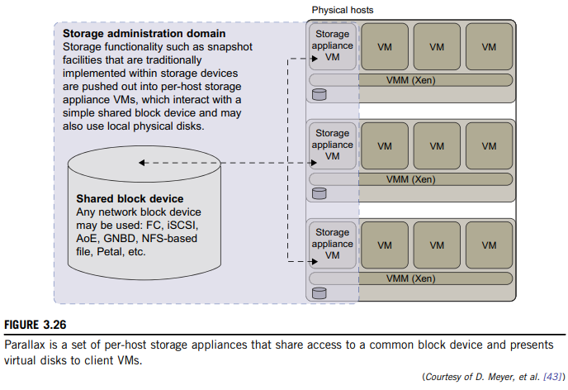

Slide 9
Cloud OS for Virtualized Data Centers
Data centers must be virtualized to serve as cloud providers.
Table 3.6 summarizes four virtual infrastructure (VI) managers and Oses – which are tailored for virtualizing data centers.
Nimbus, Eucalyptus & OpenNebula - open source software available to the general public.
Only vSphere 4 - a proprietary OS for cloud resource virtualization & management over data centers.
Nimbus and Eucalyptus support essentially virtual networks. OpenNebula has additional features to provision dynamic resources and make advance reservations.
All three public VI managers apply Xen and KVM for virtualization, but vSphere 4 uses hypervisors ESX & ESXi from VMware.

Slide 10
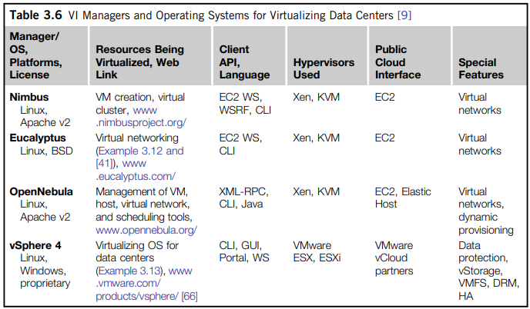

Slide 11
Trust Management in Virtualized Data Centers
A VMM changes the computer architecture. It provides a layer of software between the operating systems and system hardware to create one or more VMs on a single physical platform.
A VM encapsulates the state of the guest operating system running inside it.
Encapsulated machine state can be copied and shared over the network and removed like a normal file, which proposes a challenge to VM security.
In general, a VMM can provide secure isolation. Normally, one VM is taken as a management VM to have some privileges such as creating, suspending, resuming, or deleting a VM.
Once a hacker successfully enters the VMM or management VM, the whole system is in danger.
Considering a VM, rolling back to a point after a random number has been chosen, but before it has been used, resumes execution; the random number, which must be “fresh” for security purposes, is reused.

Slide 12
VM-Based Intrusion Detection:
Intrusions are unauthorized access to a certain computer from local or network users and intrusion detection is used to recognize the unauthorized access.
An intrusion detection system (IDS) is built on operating systems, and is based on the characteristics of intrusion actions.
A typical IDS can be classified as a host-based IDS (HIDS) or a network-based IDS (NIDS), depending on the data source.
A HIDS can be implemented on the monitored system. When the monitored system is attacked by hackers, the HIDS also faces the risk of being attacked.
A NIDS is based on the flow of network traffic which can’t detect fake actions.
Virtualization-based intrusion detection can isolate guest VMs on the same hardware platform.

Slide 13
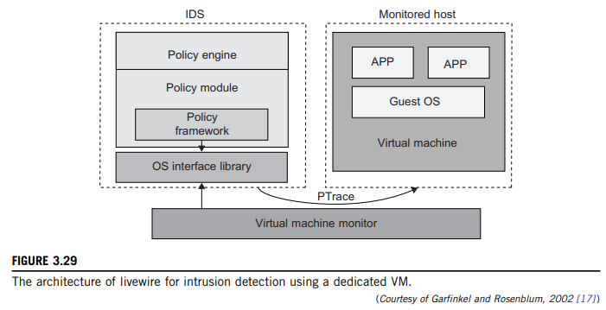
Even some VMs can be invaded successfully; they never influence other VMs, which is similar to the way in which a NIDS operates.
Furthermore, a VMM monitors and audits access requests for hardware and system software. This can avoid fake actions and possess the merit of a HIDS.
There are two different methods for implementing a VM-based IDS:
IDS is an independent process in each VM or a high-privileged VM on the VMM; or
IDS is integrated into the VMM & has same privilege to access the hardware as well as the VMM.
Figure 3.29 illustrates the concept.

Slide 14
The VM-based IDS contains a policy engine and a policy module.
Policy framework monitor events in different guest VMs by operating system interface library .
PTrace indicates trace to secure policy of monitored host.
It’s difficult to predict & prevent all intrusions without delay. Therefore, an analysis of the intrusion action is extremely important after an intrusion occurs.
At the time of this writing, most computer systems use logs to analyze attack actions, but it is hard to ensure the credibility and integrity of a log.
The IDS log service is based on the operating system kernel.
Besides IDS, honeypots and honeynets are also prevalent in intrusion detection.
They attract and provide a fake system view to attackers in order to protect the real system.

